Slide 1
River Basin Management Cycle Training Series
Case Study – Pamba River Basin

Slide 2
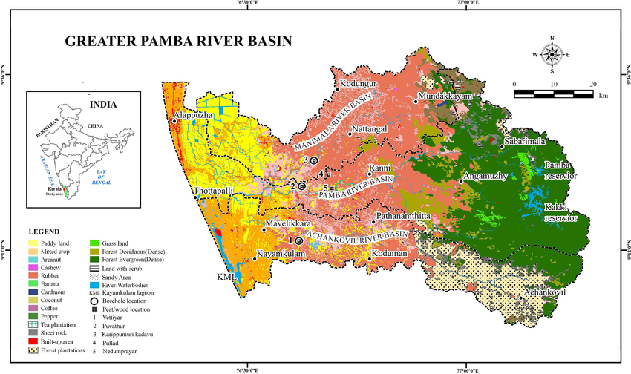
About 2,200 km².
Third largest river in Kerala.
- 2 -

Slide 3
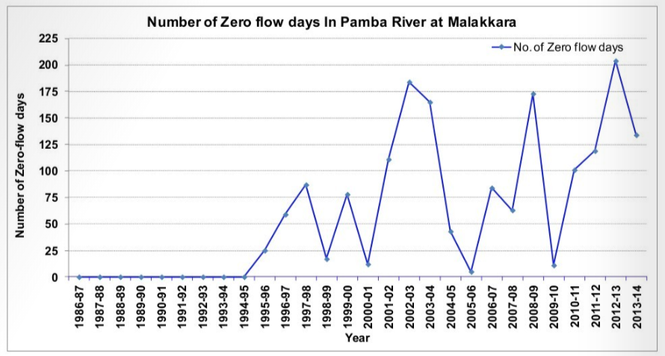
Pamba River Basin – Pamba River Basin Authority
Main challenges in the basin
Reduced water availability
Anthropogenic waste: lack of sanitary latrines, lack of facilities for sewage collection and treatment
Turbidity and organic pollution: sand mining, encroachment, sedimentation of reservoirs
Source: Report on the issue of decreasing flows in Pamba and Periyar Rivers in Kerala (2014)
- 3 -

Slide 4
Pamba River Basin – Legal Background for Pamba River Basin Authority
Pamba River Basin Authority Bill (2009)
The bill established the Pamba River Basin Authority as a statutory body for conservation of water resources in the Pamba River Basin.
Preamble states “the government is bound to ensure the quality of water in the river and to take measures to prevent pollution and to undertake integrated planning, monitoring, management and development of water resources in the river with the river basin as an integral unit.”
It has the power to impose controls or restrictions over the exploitation of natural resources or encroachments that have an impact on the water resources and the basins of the Pamba River.
- 4 -

Slide 5
Pamba River Basin – Legal Background for Pamba River Basin Authority
The Basin Authority is represented by stakeholders from 15 different governmental sectors as well as autonomous representatives:
Chairman: the chief minister
Vice-chairman: Kerala’s Water Resources Minister
Member Secretary : Water Resources secretary
Chairman of the Kerala State Pollution Control Board
Secretaries of various departments such as Revenue, Forest, Local Self-government, Health, Science and Technology and Environment, Finance, Power and Devaswom.
Two water sector experts
Two members of the House of the People, nominated by Government, representing the constituencies
Two members of the Legislative Assembly, nominated by Government, representing the legislative constituencies
Presidents of the District Panchayats
PRBA organigram
Pamba River Basin Authority Bill (2009)
- 5 -

Slide 6
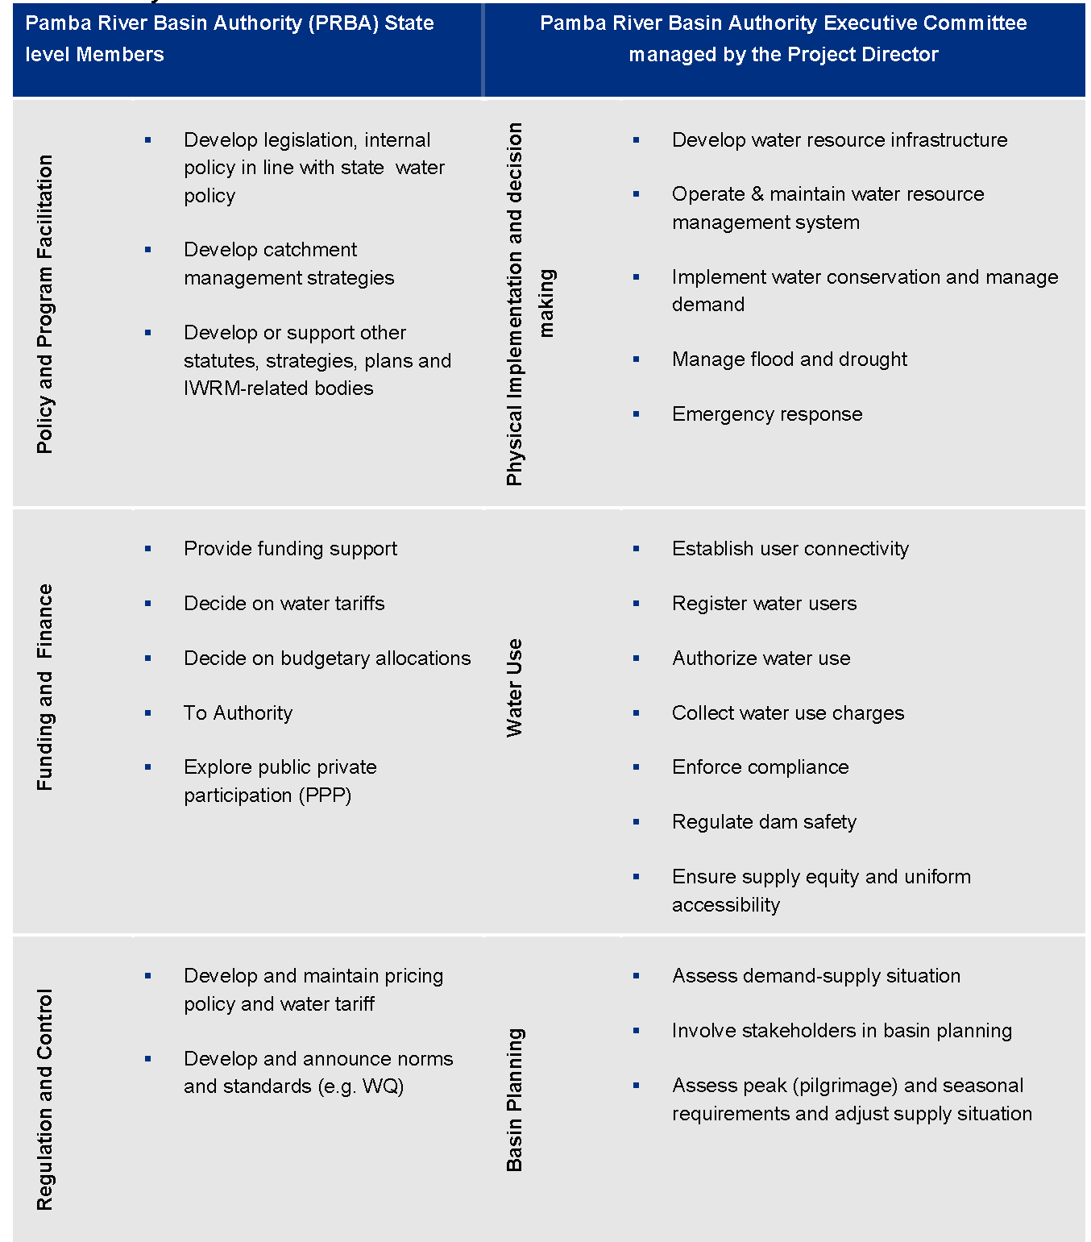
Pamba River Basin – Legal Background for Pamba River Basin Authority
Key functions of the PRBA
PRBA organigram
Source: Project “Developing a Roadmap for the Pamba river” (EU-India Action Plan Support Facility, 2010)
Pamba River Basin Authority Bill (2009)
- 6 -

Slide 7
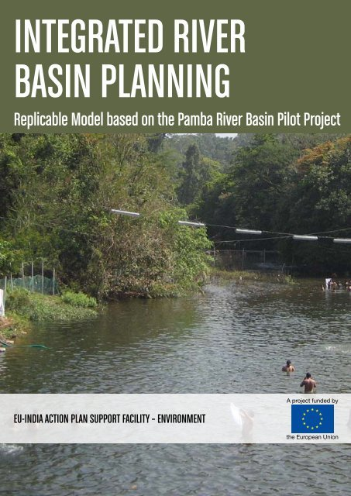
Pamba River Basin – Roadmap Development
The EU-India Action Plan Support Facility conducted in 2010 the project “Developing a Roadmap for the Pamba river”.
Implemented through targeted training/working sessions and consultations of a broad spectrum of stakeholder.
It supported the newly set up Pamba River Basin Authority in devising a management plan for future priority actions.
Objective was to evolve water management in the State to a sustainable water resources management practice that is cross sectoral, decentralized, and at the scale of the basin.
The main actions identified in the Roadmap were:
the immediate need for operationalization of the Pamba River Basin Authority,
adequate and thorough capacity building at State and local level in IWRM practices,
and the development of a full IWRM Action Plan for the Pamba River.
- 7 -

Slide 8
Pamba River Basin – Roadmap Development II
Development of an IWRM Action Plan
Involvement of ca 80 representative stakeholders.
Water resources issues identified and ranked in accordance to their importance.
Identification of water management constraints and possible solutions.
Preparation of an IWRM Roadmap, with identification of measures, timeline, responsible organisation and definition of monitoring indicators.
- 8 -

Slide 9
Pamba River Basin – Roadmap Development III
Development of an IWRM Action Plan
Source: Project “Developing a Roadmap for the Pamba river” (EU-India Action Plan Support Facility, 2010)
- 9 -

Slide 10
Actual status of the Pamba River Basin Authority (PRBA)
As of today, the PRBA is not operational. Actions on the ground were not taken to the level to which it should have been undertaken.
According to the former Director of the PRBA, the reasons are:
It was not given priority by the Government
Lack of leadership
Lack of financial resource allocation
Apprehension by the stakeholders that this is not going to be feasible in Kerala/India
Frequent transfers of the officials
Lack of functioning of the various related departments in an integrated manner, even conflicts
Departments members of the PRBA have undertaken their respective activities which happen to enable/facilitate the PRBA. But these activities were not integrated.
A strong leadership can make a huge difference as the Chief Minister is the Chairman of PRBA.
- 10 -

Slide 11
River Basin Authority (RBA) in Kerala
RBA organigram
In 2018, Kerala state government announced its plan to establish a River Management Authority for the 44 rivers in the State.
Proposed set-up of the RBA:
Governing Council
Executive Committee
Advised by an Advisory Committee:
Provide technical advices
Without any decision-making powers
Source: Note from the Chief Engineer Irrigation & Administration Thiruvananthapuram, dated 25/03/2019
- 11 -

Slide 12
River Basin Authority (RBA) in Kerala
Governing Council:
Chairman: Chief Minister
Vice Chairman: Kerala’s Minister for Water Resources
Secretary: the Chief Secretary
The Opposition Leader of the Legislative Assembly
Different State Ministers: Finance, Agriculture, Environment and Forest, Rural Development, Panchayats, Urban Development, Revenue, Industries, Power, Fisheries;
Vice-Chairman of the State Planning Board
Two members of the Parliament, representing the area of any of the two River Basin Boards, nominated by Government
Three members of the Legislative Assembly, representing the area of any of the three River Basin Boards, nominated by Government
Two representatives of NGO, nominated by Government
RBA organigram
- 12 -

Slide 13
River Basin Authority (RBA) in Kerala
Powers, Functions and Responsibilities of the Governing Council
Apex body for the coordination, convergence and integration of policies and programs.
Main functions
Approve River Basin Plans submitted by the Executive Committee.
Monitor the progress and outcomes of the implementation of the River Basin Plans;
Lead the communication campaign and monitor the activities related to awareness creation and behavior change among the public and ensure the participation of all stakeholders concerned.
Recommend to the Government on the inter-basin and intra-basin water transfer and allocations.
Oversee the inter-state agreements.
- 13 -

Slide 14
River Basin Authority (RBA) in Kerala
RBA organigram
Executive Committee
Chairman: the Chief Secretary.
Vice-Chairperson: Secretary of Kerala’s Water Resources Department.
Secretary: the Chief Executive officer.
Member Secretary of Kerala State Pollution Control Board.
Directors of State Department: Irrigation and Administration, Kerala Water Authority, Groundwater Department, Environment and Climate Change, Conservator of Forests, Agriculture Department, Soil Survey and Soil Conservation Department, Science and Technology and Environment Department, Electricity Board Limited, Center for Water Resources Development and Management.
River Basin Board representatives.
- 14 -

Slide 15
River Basin Authority (RBA) in Kerala
Powers, Functions and Responsibilities of the Executive Committee
Coordination, convergence and integration of policies, and programs.
Approve River Basin Plans prepared by River Basin Boards.
Prepare, implement and monitor river basin plans for rivers where separate boards are not formed.
Recommend specific measures and programs.
Monitor the progress and outcomes of the implementation of the River Basin Plans.
Monitor the projects and programs of Government Departments and Agencies and ensure that they are in consonance with River Basin Plans.
Resolve water disputes and conflicts in the River Basins through conciliation.
Design and roll out effective communication strategy and campaigns for the conservation of rivers.
- 15 -

Slide 16
River Basin Authority (RBA) in Kerala
RBA organigram
River Basin Boards (3 to 4)
Chairman: Chief Engineer, Irrigation Department.
Superintending Engineer(s) of the Irrigation Department.
Regional Officer, Kerala State Pollution Control Board.
Local Departments: Executive Engineers Kerala Water Authority, Groundwater Department, Agriculture Department, District Officer Soil Survey, District Soil Conservation Officer, Divisional Forest Officer, Kerala State Electricity Board Limited, Fisheries Department, Project Director, Rural Development Department.
Basin management committee representatives.
- 16 -

Slide 17
River Basin Authority (RBA) in Kerala
Powers, Functions and Responsibilities of the River Basin Boards
To prepare River Basin Plan.
Carry out activities under the basin plan, adopting a decentralized approach.
Integrate and co-ordinate development works carried out by various departments.
Design and develop an integrated data network and a Decision Support System (DSS).
Determine and regulate water rights, water sharing, and water transfer both inter and intra
basin levels.
Redress the disputes on water related issues within the jurisdiction of the River Basin Board and to refer to the Authority such issues which could not be resolved at their level.
Take measures, including penal or otherwise, to prevent water pollution, encroachment and any other adverse activities.
Design and roll out effective communication strategy and campaigns for sustainable management of the river basin.
Ensure participation and stakeholder engagement right from the preparation of basin plans to its implementation.
- 17 -

Slide 18
River Basin Authority (RBA) in Kerala
RBA organigram
Basin Management Committees
Members of Parliament.
Members of the Legislative Assembly.
Heads of Local Self Government Institutions.
Representatives of all registered NGOs.
District level officers of Irrigation, Agriculture, Kerala Water Authority, Groundwater, Forest, Soil Conservation, Pollution Control Board and Electricity Board.
Representative of water user groups.
- 18 -

Slide 19
River Basin Authority (RBA) in Kerala
Powers, Functions and Responsibilities of the Basin Management Committees
Plan programs and projects at sub basin level.
Collect baseline data and inventories.
Support the Board in the preparation of basin plan.
Monitor implementation of basin plan.
Monitor water quality.
Implement selected components of basin plan through community contracting.
Mobilize community participation initiatives for enforcement of pollution control in the basins.
Carry out communication campaign with specific focus on direct contact programs.
- 19 -

Slide 20
References
EU-India Action Plan Support Facility (2010) Developing a Roadmap for the Pamba river Project. URL: http://www.indiaenvironmentportal.org.in/files/Final_Report_IWRM_Roadmap_Pamba_Pilot_Project_2_0.pdf (access date 18.01.2020)
EU-India Action Plan Support Facility (2011) Integrated River Basin Planning - Replicable Model based on the Pamba River Basin Pilot Project. URL: http://www.indiaenvironmentportal.org.in/files/IRBPRevised_.pdf (access date 18.01.2020)
National Institute of Hydrology, Indian Institute of Technology Roorkee, Centre for Water Resources Development and Management, Central Water and Power Research Station, Central Water Commission (2014) Report on the issue of decreasing flows in Pamba and Periyar Rivers in Kerala http://www.cwrdm.org/home/publications/3/0/9# (access date 18.01.2020)
- 20 -

Slide 21
Continued engagement pre and post webinar
For queries and related engagements contact GIZ colleagues:
Delhi Office:
Dr. Sumit Gautam (sumit.gautam@giz.de)
Ms. Chhavi Sharda (chhavi.sharda@giz.de)
Uttarakhand (Dehradun) Office:
Mr. Merajuddin Ahmad (merajuddin.ahmad@giz.de)
2. E-Learning platform - http://78.46.247.119/
( Temporarily hosted on AHT servers and will be transferred to the servers of training institutes.)
Contact: Rania -taha@aht-group.com/ Rebecca - roblick@aht-group.com

Slide 22
Author/Responsible/Editor, etc.: AHT Group AG Management & Engineering
Design/layout, etc.: GIZ
Photo credits/sources: N.A.
URL links: Responsibility for the content of external websites linked in this publication always lies with their respective publishers. GIZ expressly dissociates itself from such content.
On behalf of German Federal Ministry for Economic Cooperation and Development (BMZ) Support to Ganga Rejuvenation, Competence in Motion, New Delhi, GIZ India
GIZ is responsible for the content of this publication.
India office:
GIZ Office New Delhi 46 Paschimi Marg, Vasant Vihar New Delhi 110057
Postal address:
Support to Ganga Rejuvenation
B-5/2, Safdarjung Enclave New Delhi 110 029 India
E: martina.burkard@giz.de/
chhavi.sharda@giz.de/
sumit.gautam@giz.de
In cooperation with:

